Slide 1
Operating System
Lecture 04

Slide 2
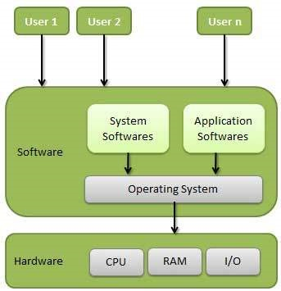
Operating System
An operating system is a program that acts as an interface between the user and the computer hardware and controls the execution of all kinds of programs.
Examples:
Some popular Operating Systems include Window, Linux, Unix, DOS(Disk Operating System), Mac OS( Macintosh Operating System etc.

Slide 3
Functions of Operating Systems
Following are some of important functions of an operating System.
Memory Management
Processor Management
Device Management
File Management
Other Important Activates
Security
Control over system performance
Job accounting
Error detecting aids
Coordination between other software and users

Slide 4
Functions of Operating Systems
(1) Memory Management
An Operating System does the following activities for memory management −
Keeps tracks of primary memory, i.e., what part of it are in use by whom, what part are not in use.
In multiprogramming, the OS decides which process will get memory when and how much.
Allocates the memory when a process requests it to do so.
De-allocates the memory when a process no longer needs it or has been terminated.

Slide 5
Functions of Operating Systems
(2) Processor Management
In multiprogramming environment, the OS decides which process gets the processor when and for how much time. This function is called process scheduling. An Operating System does the following activities for processor management −
Keeps tracks of processor and status of process. The program responsible for this task is known as traffic controller.
Allocates the processor (CPU) to a process.
De-allocates processor when a process is no longer required.

Slide 6
Functions of Operating Systems
(3) Device Management
An Operating System manages device communication via their respective drivers. It does the following activities for device management −
Keeps tracks of all devices. Program responsible for this task is known as the I/O controller.
Decides which process gets the device when and for how much time.
Allocates the device in the efficient way.
De-allocates devices.

Slide 7
Functions of Operating Systems
(3) File Management
A file system is normally organized into directories for easy navigation and usage. These directories may contain files and other directions.
An Operating System does the following activities for file management −
Keeps track of information, location, uses, status etc. The collective facilities are often known as file system.
Decides who gets the resources.
Allocates the resources.
De-allocates the resources.

Slide 8
Functions of Operating Systems
Other Important Activities
Following are some of the important activities that an Operating System performs −
Security − By means of password and similar other techniques, it prevents unauthorized access to programs and data.
Control over system performance − Recording delays between request for a service and response from the system. Log files
Job accounting − Keeping track of time and resources used by various jobs and users.
Error detecting aids − Production of dumps, traces, error messages, and other debugging and error detecting aids.
Coordination between other software and users − Coordination and assignment of compilers, interpreters, assemblers and other software to the various users of the computer systems.

Slide 9
Types of Operating System
Following are the types of Operating Systems;
Batch operating system
Time-sharing operating systems
Distributed operating System
Network operating System
Real Time operating System

Slide 10
Types of Operating System
(1) Batch operating system
The users of a batch operating system do not interact with the computer directly. Each user prepares his job on an off-line device like punch cards and submits it to the computer operator. To speed up processing, jobs with similar needs are batched together and run as a group. The programmers leave their programs with the operator and the operator then sorts the programs with similar requirements into batches.
The problems with Batch Systems are as follows −
Lack of interaction between the user and the job.
CPU is often idle, because the speed of the mechanical I/O devices is slower than the CPU.
Difficult to provide the desired priority.

Slide 11
Types of Operating System
(2) Time-sharing operating systems
Time-sharing is a technique which enables many people, located at various terminals, to use a particular computer system at the same time. Time-sharing or multitasking is a logical extension of multiprogramming. Processor's time which is shared among multiple users simultaneously is termed as time-sharing.
Advantages of Timesharing operating systems are as follows −
Provides the advantage of quick response.
Avoids duplication of software.
Reduces CPU idle time.

Slide 12
Types of Operating System
(3) Distributed operating System
Distributed systems use multiple central processors to serve multiple real-time applications and multiple users. Data processing jobs are distributed among the processors accordingly.
The processors communicate with one another through various communication lines (such as high-speed buses or telephone lines). These are referred as loosely coupled systems or distributed systems. Processors in a distributed system may vary in size and function. These processors are referred as sites, nodes, computers, and so on.
The advantages of distributed systems are as follows −
With resource sharing facility, a user at one site may be able to use the resources available at another.
Speedup the exchange of data with one another via electronic mail.
If one site fails in a distributed system, the remaining sites can potentially continue operating.
Better service to the customers.
Reduction of the load on the host computer.
Reduction of delays in data processing.

Slide 13
Types of Operating System
(4) Network operating System
A Network Operating System runs on a server and provides the server the capability to manage data, users, groups, security, applications, and other networking functions. The primary purpose of the network operating system is to allow shared file and printer access among multiple computers in a network, typically a local area network (LAN), a private network or to other networks.
Examples of network operating systems include Microsoft Windows Server 2003, Microsoft Windows Server 2008, UNIX, Linux, Mac OS X, Novell NetWare, and BSD.
The advantages of network operating systems are as follows −
Centralized servers are highly stable.
Security is server managed.
Upgrades to new technologies and hardware can be easily integrated into the system.
Remote access to servers is possible from different locations and types of systems.

Slide 14
Types of Operating System
(5) Real Time operating System
A real-time operating system is an operating system intended to serve real-time applications that process data as it comes in, typically without buffer delays. Processing time requirements are measured in tenths of seconds or shorter increments of time. A real-time system is a time bound system which has well defined fixed time constraints. Processing must be done within the defined constraints or the system will fail.
The advantages of Real Time operating systems are as follows −
A key characteristic of an RTOS is the level of its consistency concerning the amount of time it takes to accept and complete an application's task.
The chief design goal is performance.

Slide 15
User Interfaces and its Types
User interface: “How a user interacts with a computer”
or
“A user interface (UI) refers to the part of an operating system, program, or device that allows a user to enter and receive information.”
Types:
Graphical user interface (GUI)
Command line interfaces

Slide 16
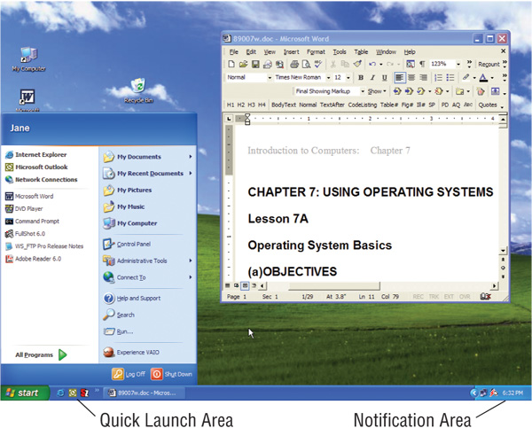
Graphical user interface (GUI)
In most operating systems, the primary user interface is graphical, i.e. instead of typing the commands you manipulate various graphical objects (such as icons) with a pointing device. The underlying principle of different graphical user interfaces (GUIs) is largely the same, so by knowing how to use a Windows UI, you will most likely know how to use Linux or some other GUI.
Most GUIs have the following basic components:
a start menu with program groups
a taskbar showing running programs
a desktop
various icons and shortcuts.

Slide 17
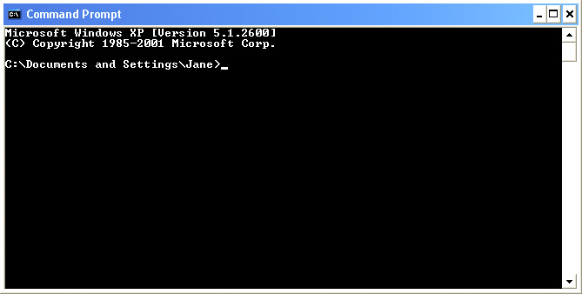
Command line interfaces
Older interface
DOS, Linux, UNIX
User types commands at a prompt
Included in all GUIs

Slide 18
Operating System Scheduling algorithms
A Process Scheduler schedules different processes to be assigned to the CPU based on particular scheduling algorithms. There are few popular process scheduling algorithms which we are going to discuss −
First-Come, First-Served (FCFS) Scheduling
Shortest-Job-Next (SJN) Scheduling
Priority Scheduling
Shortest Remaining Time
Round Robin(RR) Scheduling

Slide 19
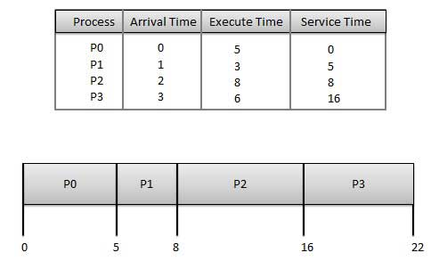
Operating System Scheduling algorithms
(1)First Come First Serve (FCFS):
Jobs are executed on first come, first serve basis.
Easy to understand and implement.
Its implementation is based on FIFO queue.
Poor in performance as average wait time is high.

Slide 20
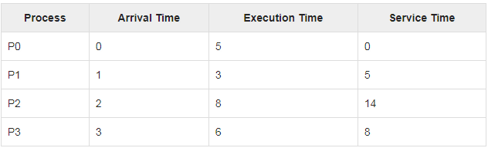
Operating System Scheduling algorithms
(2) Shortest-Job-Next (SJN) Scheduling
This is also known as shortest job first, or SJF
Best approach to minimize waiting time.
Easy to implement in Batch systems where required CPU time is known in advance.
Impossible to implement in interactive systems where required CPU time is not known.
The processer should know in advance how much time process will take.

Slide 21
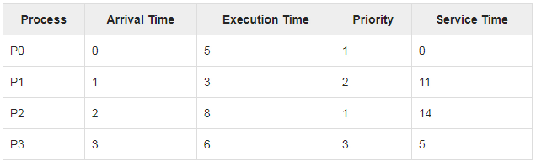
Operating System Scheduling algorithms
(3) Priority Based Scheduling
Priority scheduling is one of the most common scheduling algorithms in batch systems.
Each process is assigned a priority. Process with highest priority is to be executed first and so on.
Processes with same priority are executed on first come first served basis.
Priority can be decided based on memory requirements, time requirements or any other resource requirement.

Slide 22
Operating System Scheduling algorithms
(4) Shortest Remaining Time
Shortest remaining time (SRT) is the another version of the SJN algorithm.
The processor is allocated to the job closest to completion but it can be preempted by a newer ready job with shorter time to completion.
Impossible to implement in interactive systems where required CPU time is not known.
It is often used in batch environments where short jobs need to give preference.

Slide 23
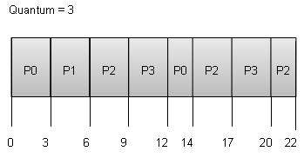
Operating System Scheduling algorithms
(5) Round Robin Scheduling
Round Robin is the preemptive process scheduling algorithm.
Each process is provided a fix time to execute, it is called a quantum.
Once a process is executed for a given time period, it is preempted and other process executes for a given time period.
Context switching is used to save states of preempted processes.

Slide 24
Important Questions
What is an operating system? | An operating system is a program that manages the computer hardware. it act as an intermediate between a users of a computer and the computer hardware. It controls and coordinates the use of the hardware among the various application programs for the various users.
What is the kernel? | A more common definition is that the OS is the one program running at all times on the computer ,usually called the kernel, with all else being application programs.
What are batch systems? | Batch systems are quite appropriate for executing large jobs that need little interaction. The user can submit jobs and return later for the results. It is not necessary to wait while the job is processed.
What is real time system? | A real time system has well defined ,fixed time constraints. Processing must be done within the defined constraints, or the system will fail. It is often used as a control device in a dedicated application.
What do you mean by system calls? | System calls provide the interface between a process and the operating system. When a system call is executed, it is treated as by the hardware as software interrupt.
What is a process? | A process is a program in execution. It is an active entity and it includes the process stack, containing temporary data and the data section contains global variables.
What is scheduler? | A process migrates between the various scheduling queues throughout its life time. The OS must select processes from these queues in some fashion. This selection process is carried out by a scheduler.
What are the use of job queues, ready queues and device queues? | As a process enters a system they are put in to a job queue. This queues consist of all jobs in the system. The processes that are residing in main memory and are ready and waiting to execute are kept on a list called ready queue. The list of processes waiting for a particular I/O devices kept in the device queue.
What is deadlock? | A process requests resources; if the resources are not available at that time, the process enters a wait state. Waiting processes may never again change state, because the resources they have requested are held by other waiting processes. This situation is called a deadlock.

